Slide 1


Slide 2
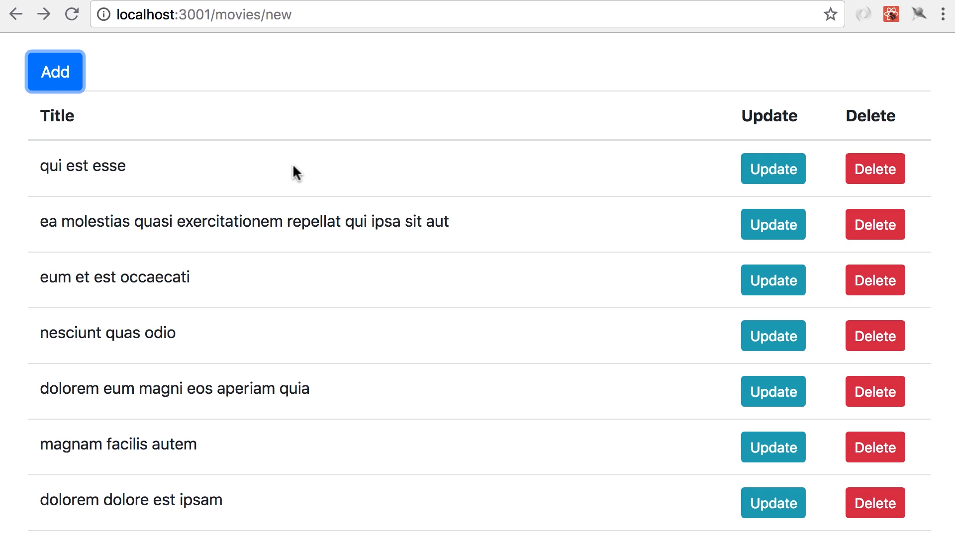
When ever we click on add delete or update there is a delay of a sec or half sec the reason is

Slide 3
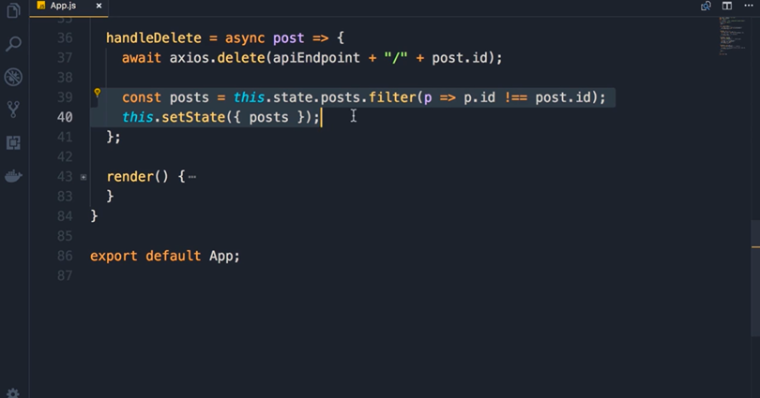
We are calling the server first and then updating the view hence there is a delay if there is an error in connecting to the server then the next two lines wll not work and this is called pessimistic update.

Slide 4
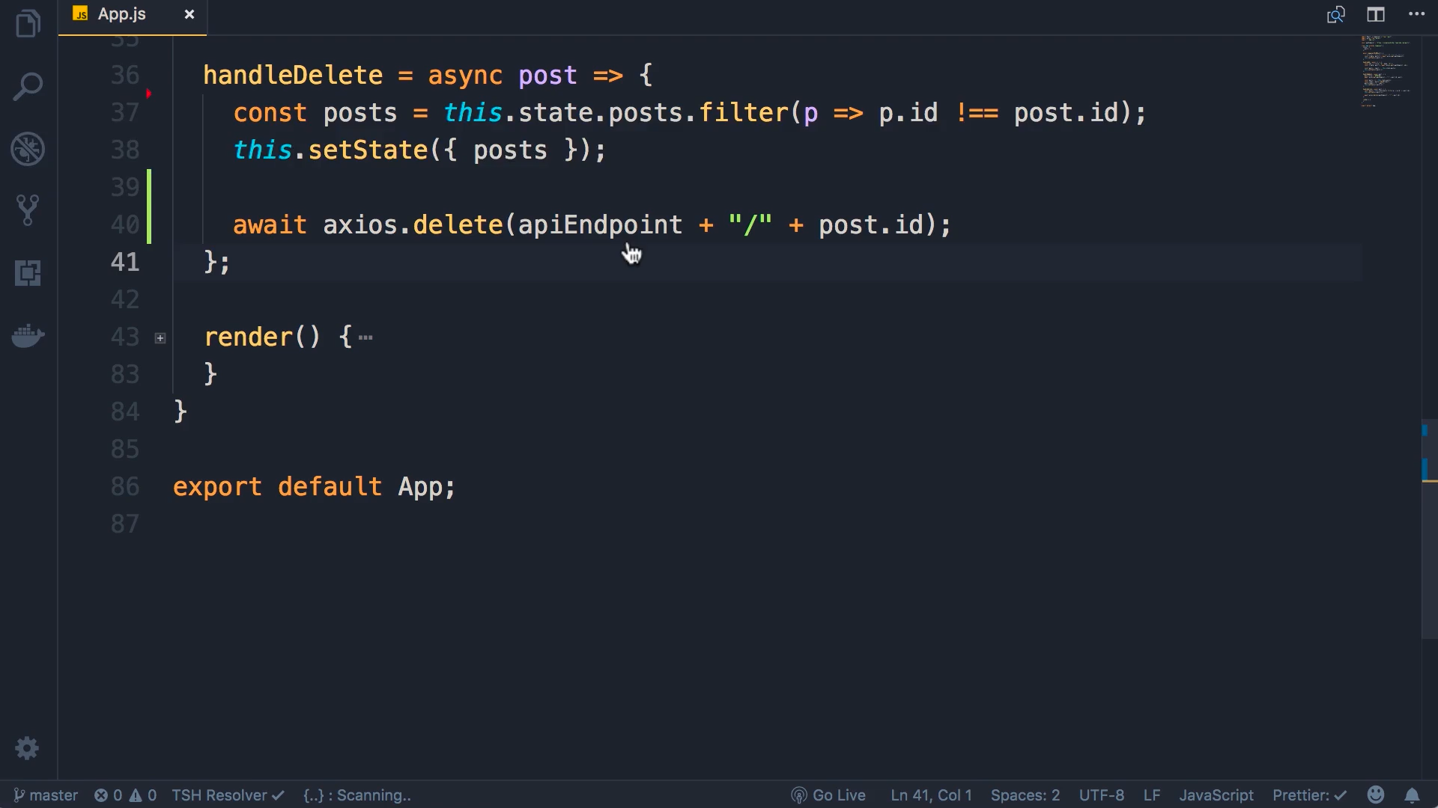
This is optimistic update in which we are updating the UI (setState) and later we are calling the server. If in can the connectivity to the server fails we can revert back the ui

Slide 5
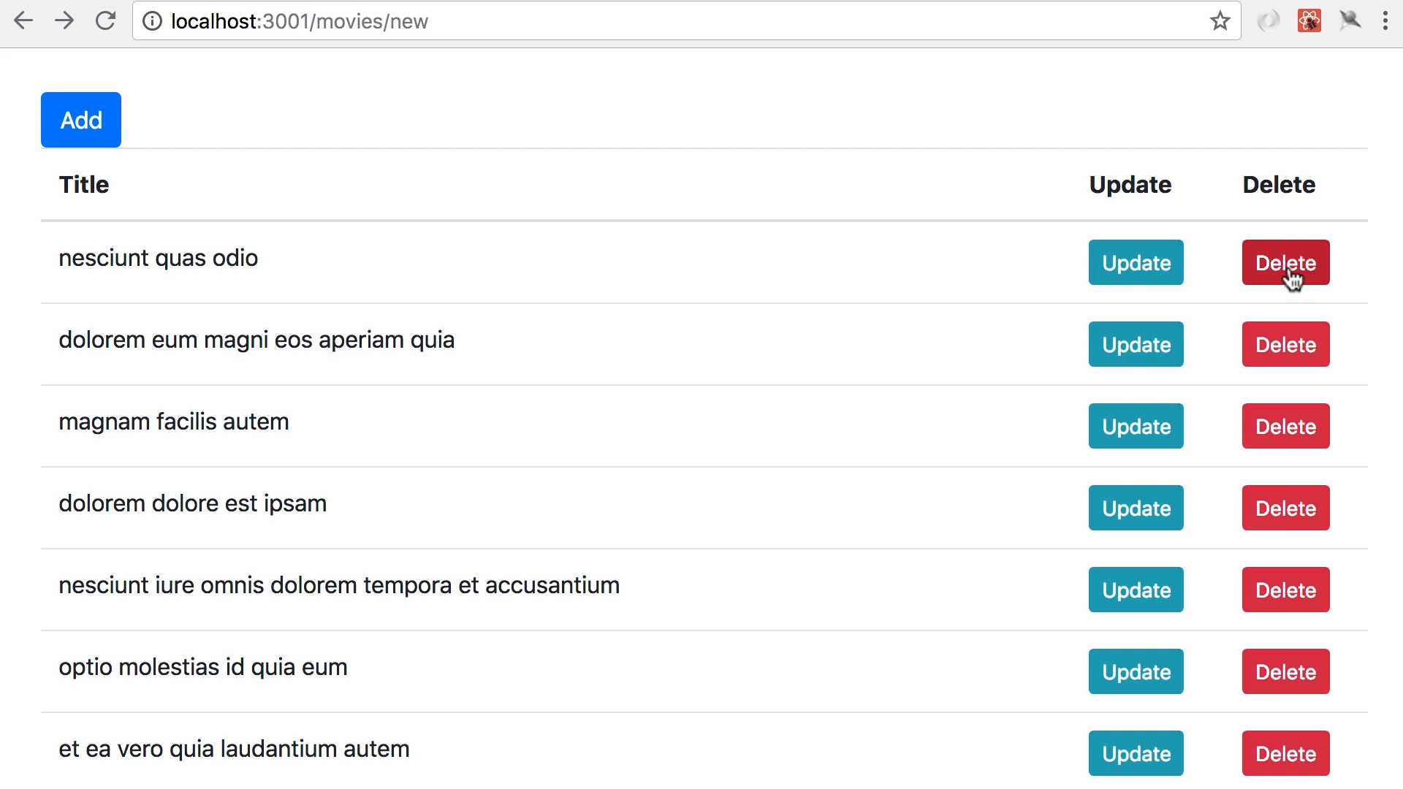
Now check that the delete executes very fast

Slide 6
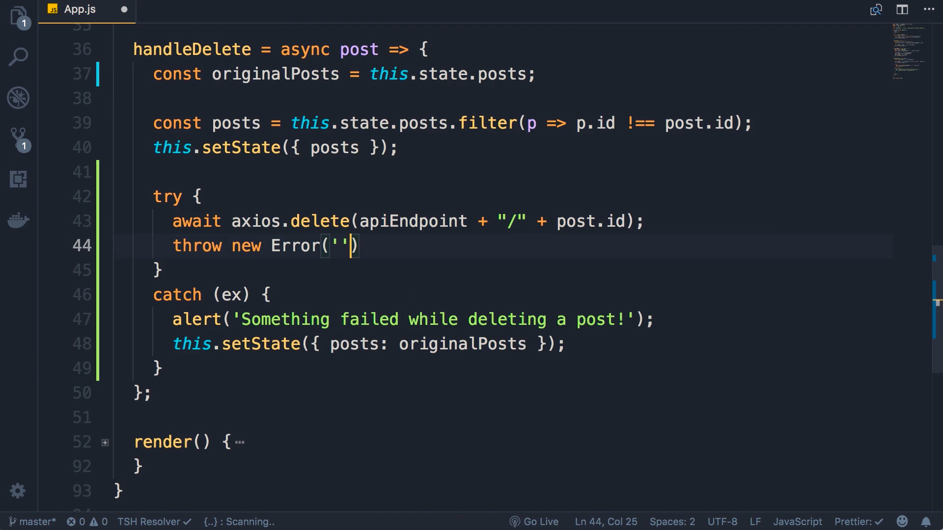
But what if there is a server connectivity error we can revert back to the previous state which is very easy in react. Observe though there is no error we are simulating a error

Slide 7
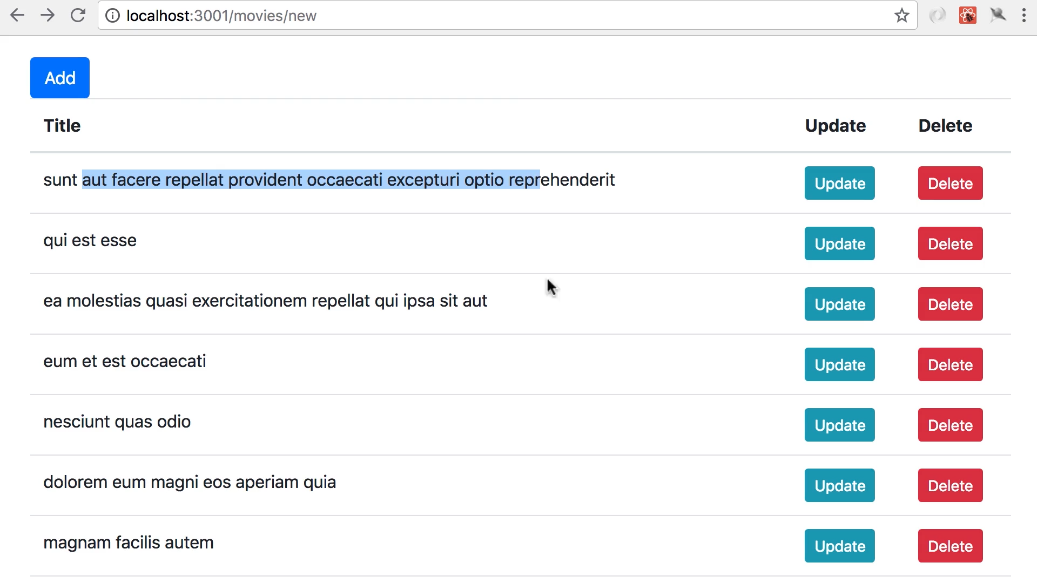
Click on delete the post is deleted but there isan error so alert appears and the post which is deleted appears again

Slide 8
